Slide 1
OVERWORKED
Team magiykadzhiyte
A project for Hack TUES 11

Slide 2
TABLE OF CONTENTS
01
03
04
05
02
OUR TOPIC
OUR DEMO
OUR TEAM
How our project connects to the topic of the event
How our game looks at the moment
Who we are and what we did
OUR TECHNOLOGIES
OUR PLANS
What we used to create our project
What we plan for the future

Slide 3
01
OUR TOPIC
How our project connects to the topic of the event

Slide 4

The Problem
Our Solution
Irresponsibility towards finances, caused by lack of information and willingness to acquire it
A co-op endless resource management game where you can learn all about finances

Slide 5
HOW TO MANAGE FINANCES?
CAUTION
PLANNING
CONSULTING
The fast paced gameplay will force you to think twice before making an irresponsible purchase
Trough countless orders you will learn which assignments are worth accepting and which aren’t
Trough the co-op experience, the players can exchange their knowledge on financial management

Slide 6

OUR DEMO
02
How our game looks at the moment

Slide 7
03
OUR TEAM
Who we are and what we did

Slide 8





Dimitar
Kristian
Pavel
Toni
Alexander
The functionality wizard
The connection master
The designer
The logic mastermind
The UI expert
- The stage assets - The player assets - The workstation assets
- The order generation - The daily reports - The computer system
- The storage UI - The production minigame UI - The resource and product assets
- The storage system
- The stamping minigame
- The player and their interactions
- The multiplayer connections
- The multiplayer synchronization
- The production minigame

Slide 9
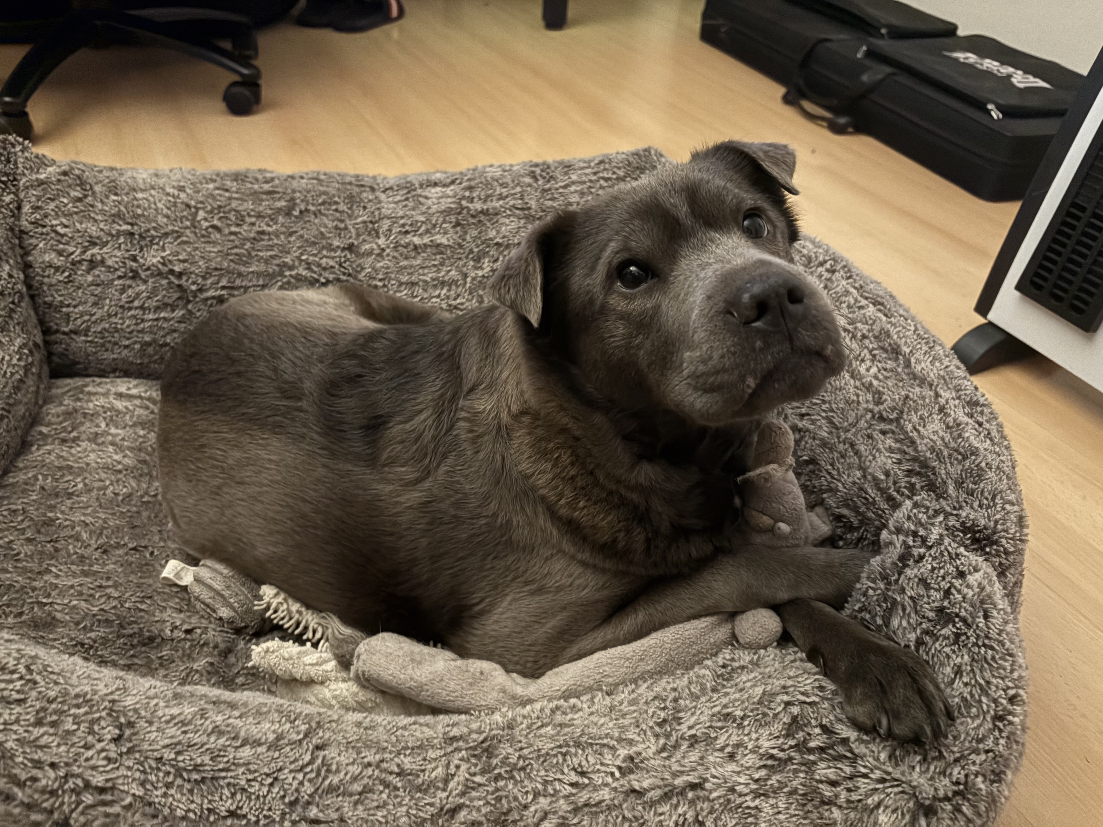
SPECIAL THANKS TO OUR MENTOR!
ANDREA
The coordinator
- Helped on all fronts
- Guided us in our workflow - Kept us sane :P

Slide 10
04
OUR TECHNOLOGIES
What we used to create our project

Slide 11

THE SOLUTION
GODOT ENGINE

Slide 12
05
OUR PLANS
What we plan for the future

Slide 13
THE NEXT STEPS
Facility reinforcement
HR position
Automation
Contracts

Slide 14
ANY QUESTIONS?

Slide 15
THANKS

Slide 16


